Slide 1

Integrated Modelling Technology workshop
June 8-10, 2011
Cadarache, France
Computational efficiently and simulation architecture
S. Matteo:sophie.matteo@c-s.fr
J Courquet: joel.courquet@c-s.fr
CS Communication & Systèmes, Cite de la Grande Bastide Bat 914 13115 St Paul lez Durance Cedex France

Slide 2
Computational efficiently and simulation architecture
Motivation: Business & IS objectives
Customer Strategic Business Objectives
  Improve Design maturity at a specific Prg milestone (Program & Designer Customers)
    Perform more realistic behavioural evaluation of the Product before its production.
    Test the Product beyond the limits of the current Means of Compliance
    Increase the Matrix of Tests (zero omission) by Multiplying M&S as Means of Compliance
  Improve Test Means Maturity.
    Reduce unitary test Lead-Time (Right-First Time for Physical Tests)
    Get faster validated test results
  Reduce Test campaign lead-time
    Support Real Test campaign to rapidly understand and fix some issues
  Reduce overall hybrid (Virtual + Physical) Test costs
    Release the complexity of the physical tests
    Define the appropriate Mean of Compliance for any V&V requirements and support the definition of the overall Test strategy.
Strategic IS objectives
  Federation and standardization of Modelling and Simulation technologies

Slide 3



Computational efficiently and simulation architecture
Motivation: Business & IS objectives
Domain of interest
Physical model
Mathematical modelling
Mathematical analysis
Numerical Analysis
Implementation
Physical problem
Method / scheme
Error estimation
Solving Algorithm
Equations
Existence / unicity
Analytical solution
Programming
Optimisation
PIRT
Conservation laws
HPC
Domain
Code
Mathematical modelling
Programming

Slide 4
Computational efficiently and simulation architecture
Domain
Scenario Identification: Operational and accident scenarios that require analysis are identified
The objective of a PIRT exercise is to identify phenomena associated with the intended scenario and to then rank the current state of knowledge relative to each identified phenomenon.
1. Understand the given scenario and figure of merit, and ask clarifying questions as needed.
2. Identify phenomena of interest and, as appropriate, key parameters associated with any identified phenomena.
3. Rank the importance of each phenomenon in the context of the figure of merit.
4. Rank the state of knowledge of phenomenon relative to the adequacy of existing modeling tools, the availability of supporting experimental data, and the prospects for gathering data if existing data were not ranked as “high”.
5. Rank the importance and state of knowledge for any key parameters identified for any given phenomenon
For each Scenario
PIRT: Important phenomena are identified for each scenario (Phenomena Identification & Ranking tables)
PCMM: Predictive Capability Maturity Model for
Computational Modeling and Simulation
Validation: Analysis tools are evaluated to determine whether important Phenoma can be calculated
Yes
No
Development:
If important phenomena
cannot be calculated by analysis tools, then further development is undertaken
See ref:
SANDIA REPORT
SAND2007-5948
Unlimited Release
Printed October 2007
Predictive Capability Maturity Model for Computational Modeling and Simulation
William L. Oberkampf, Martin Pilch, and Timothy G. Trucano
Yes
Analysis:
The operational and accident scenarios that require study are analyzed

Slide 5
Computational efficiently and simulation architecture
Verification & Validation
Verification: The process of determining that a model implementation accurately represents the developer’s conceptual description of the model and the solution to the model
Validation: The process of determining the degree to which a model is an accurate representation of the real world from the perspective of the intended uses of the model
Two Types of Verification:
Code Verification: Verification activities directed toward:
  Finding and removing mistakes in the source code
  Finding and removing errors in numerical algorithms
  Improving software using software quality assurance practices
Solution Verification: Verification activities directed toward:
  Assuring the accuracy of input data for the problem of interest
  Estimating the numerical solution error
  Assuring the accuracy of output data for the problem of interest
Verification deals with mathematics
Validation deals with physics
Programming
Mathematical modelling

Slide 6
Computational efficiently and simulation architecture
CODE VERIFICATION ACTIVITIES
Numerical Algorithm Verification
Software Quality Assurance Practices
Types of algorithm Testing:
Analytic solutions for simplified physics
ODE benchmark solutions
PDE benchmark solutions
Conservation tests
Symmetry tests
Iterative convergence tests
Configuration management
Software Quality Analysis and Testing
Static Analysis
Dynamic testting
Regression testing
Black box testing
Mathematical modelling
Programming

Slide 7









Computational efficiently and simulation architecture
Programming
  Tools
    Langage : C/C++/C#, Java, Python, VB, .Net, …
    GUI/IHM : C++/Qt, Visual Basic, Delphi, PB, …
    DB: ORACLE, Access, Sybase,…
    Communication : omniORB, CORBA
    Conception OO : UML, Rose, Visual Modler,…
  profiling
    Scalar Oprofile / PAPI / gprof / pgprof
    // Vampir/ ITAC / Jumpshot / OPT / pgprof
    Vectorial sxftrace / prof
  debug
    debugging totalview / ddt
    memory debugging purify / totalview / ddt / valgrind / e-fence
HPC
  MPI,
  OpenMP, MPI/OpenMP, MPI/vectorielle, OpenMP/Vectorielle,
  CUDA, CUDA/MPI, …TMA, MCO, …
Programming
Mathematical modelling

Slide 8
Computational efficiently and simulation architecture
Domain
Code
Mathematical modelling
Programming

Slide 9

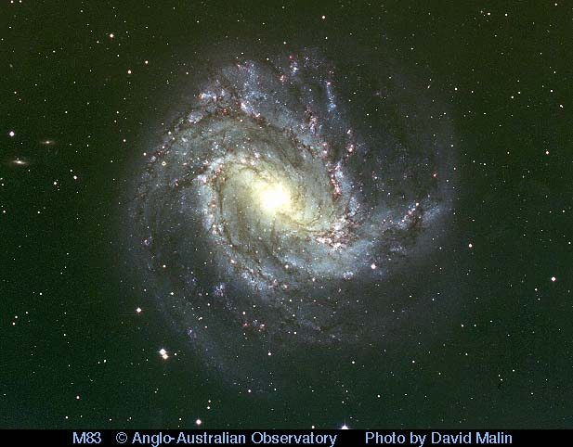
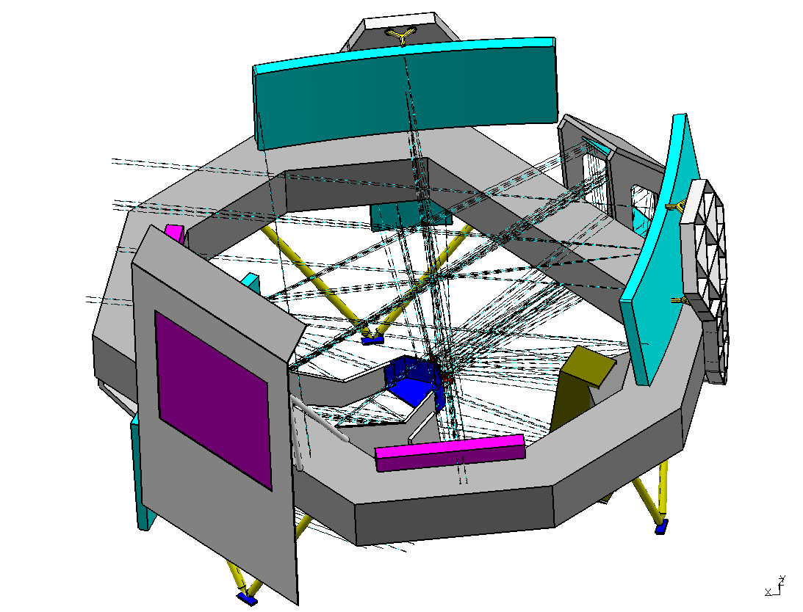
Computational efficiently and simulation architecture
The GAIA project
Astronomic satellite to be launched in 2013
To create the largest and most precise three dimensional chart of our Galaxy by providing unprecedented positional and radial velocity measurements for about one billion stars in our Galaxy and throughout the Local Group.
Done by the community
  Data Processing and Analysis Consortium (DPAC)
  ~360 active (means >=10%) participants
  Divied in 9 Coordination Units (CU)
  Top level Executive (DPACE) and Project Office (PO)
  6 Data Processing Centres to run Software
All code in Java (only one exception )
  for portability have to run till 2020
  Maintainability, testability etc.. JUnit, Hudson
  Easier to write CORRECT code in higher level language
Several ‘Relational’ Databases
  Oracle
  Postgress
  MySql
  Derby for Testing
Data Processing:
  Total data archive: 1 Petabyte
  Numerical Processing: > 1020 Flops
http://gaia.esa.int/

Slide 10

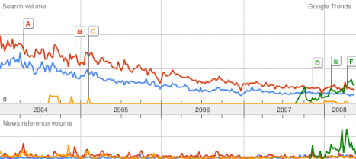









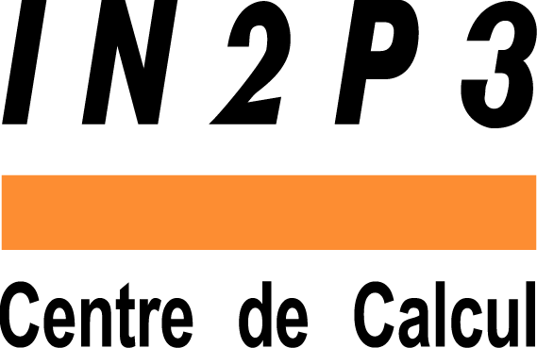







Computational efficiently and simulation architecture
GAIA: Primary targeted Architecture
2000
DataGrid (CERN)
2020
?
2001
eToile (INRIA), WLegi
2009
CSP
2002
Grasp, Rugbi (Biopôle Clermont Limagne)
2008
CILOE, OPENHPC
2003
Open Plast (Pôle Européen de plasturgie)
2007
TS2 (Teratec, Bull), SEBASTIAN
2004
EGEE 1 (CERN), eLegi
2006
EGEE 2 (CERN)
2005
Chistera/GAIA (CNES),
Visage (Airbus)
* distributed computing* grid computing* utility computing* cloud computing

Slide 11
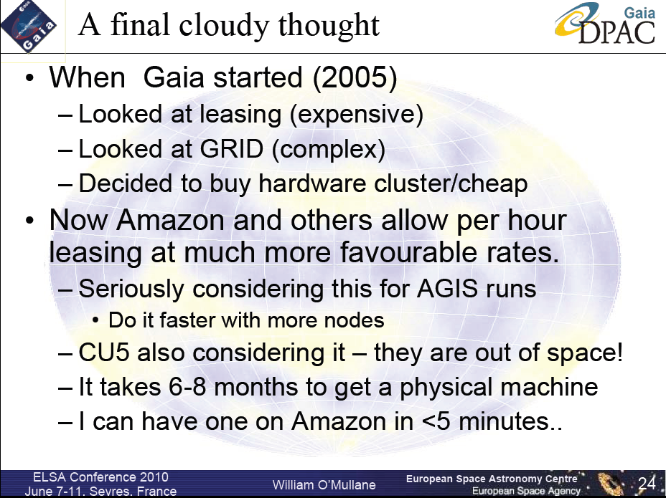
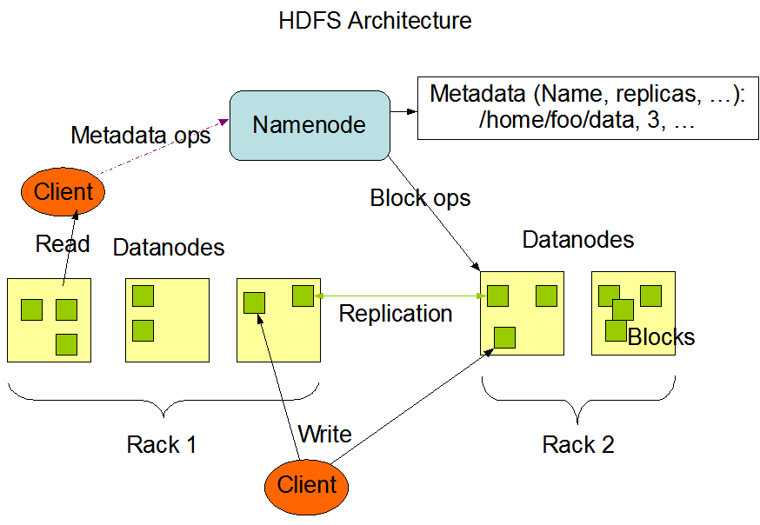
Computational efficiently and simulation architecture
GAIA: chosen Architectures
Hadoop is a framework for running applications on large clusters built of commodity hardware. The Hadoop framework transparently provides applications both reliability and data motion. Hadoop implements a computational paradigm named Map/Reduce, where the application is divided into many small fragments of work, each of which may be executed or reexecuted on any node in the cluster. In addition, it provides a distributed file system (HDFS) that stores data on the compute nodes, providing very high aggregate bandwidth across the cluster. Both Map/Reduce and the distributed file system are designed so that node failures are automatically handled by the framework.
Amazon/A9
Facebook
Google
IBM
Joost
Last.fm
New York Times
PowerSet
Veoh
Yahoo!
  http://hadoop.apache.org/core/docs/current/hdfs_design.html

Slide 12

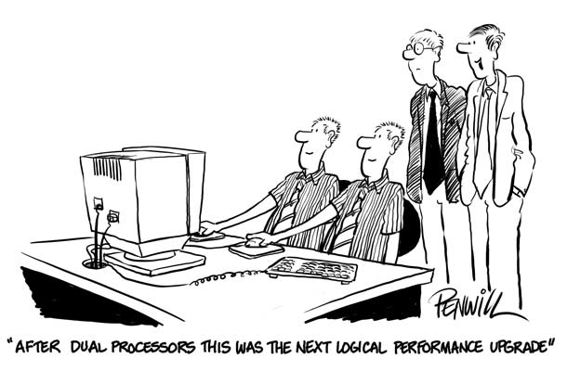
Questions

